Slide 1
Title slide
Daniel Larson, Phillip Ogborn, Corrie Thomas

Slide 2
Hypotheses
Null Hypotheses: There is no relation between danceability and popularity, or explicitness and popularity. The results happen by chance.
Alternate Hypotheses: The more danceable a song, the more popular. The more explicit a song, the more popular.

Slide 3
Questions & findings
Is there a relationship between danceability and popularity?
Is there a relationship between explicitness and popularity?
How has danceability and popularity changed over time?

Slide 4
Questions & Data
Knew right away we wanted to base our project around Spotify
Initially we looked at Spotify for Developers
Found that we couldn’t pull the data we needed from there
Moved on to Kaggle and found Spotify Dataset 1921-2020, 160k+ Tracks

Slide 5
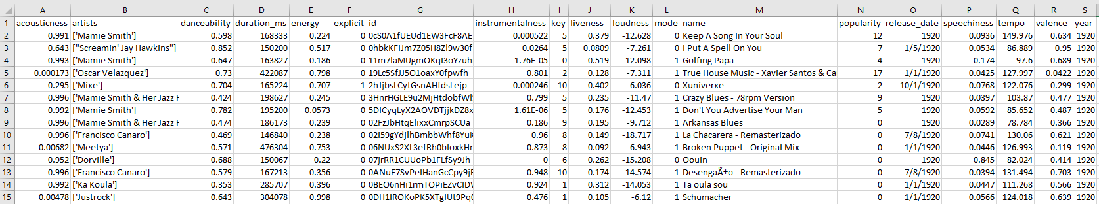
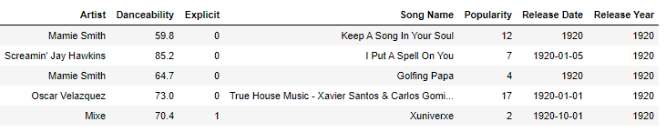
Data Cleanup & Exploration

Slide 6
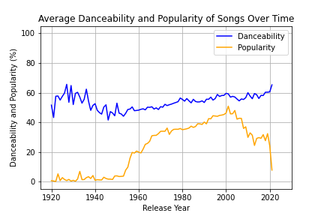
Danceability & popularity over time

Slide 7
Explicit Songs by year
(Phil’s bar chart)

Slide 8
Danceability vs popularity
(Cleaned scatter plot)

Slide 9
Linear regression
(r-value to confirm if the variability between two points on the scatter plot can be explained by danceability)

Slide 10
Ttest

Slide 11
ANOVA

Slide 12
Discussion
Findings
Difficulties

Slide 13
Questions?

